Slide 1

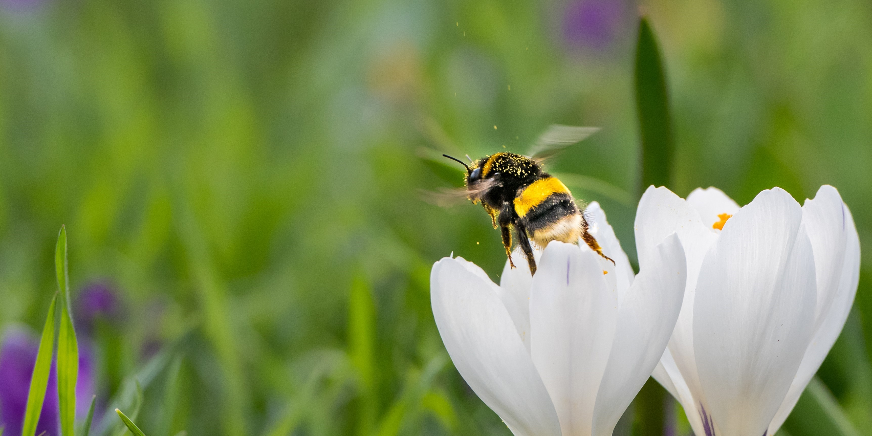
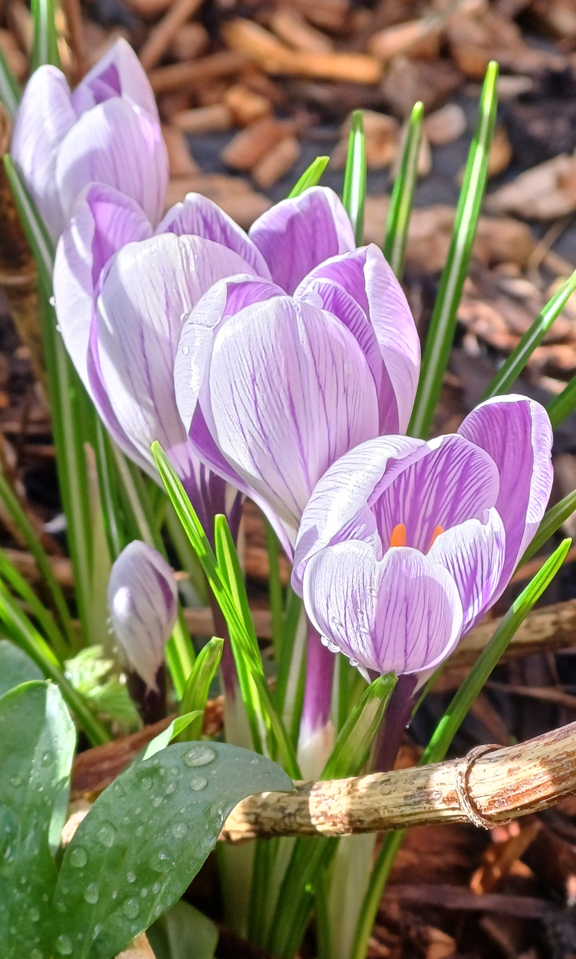
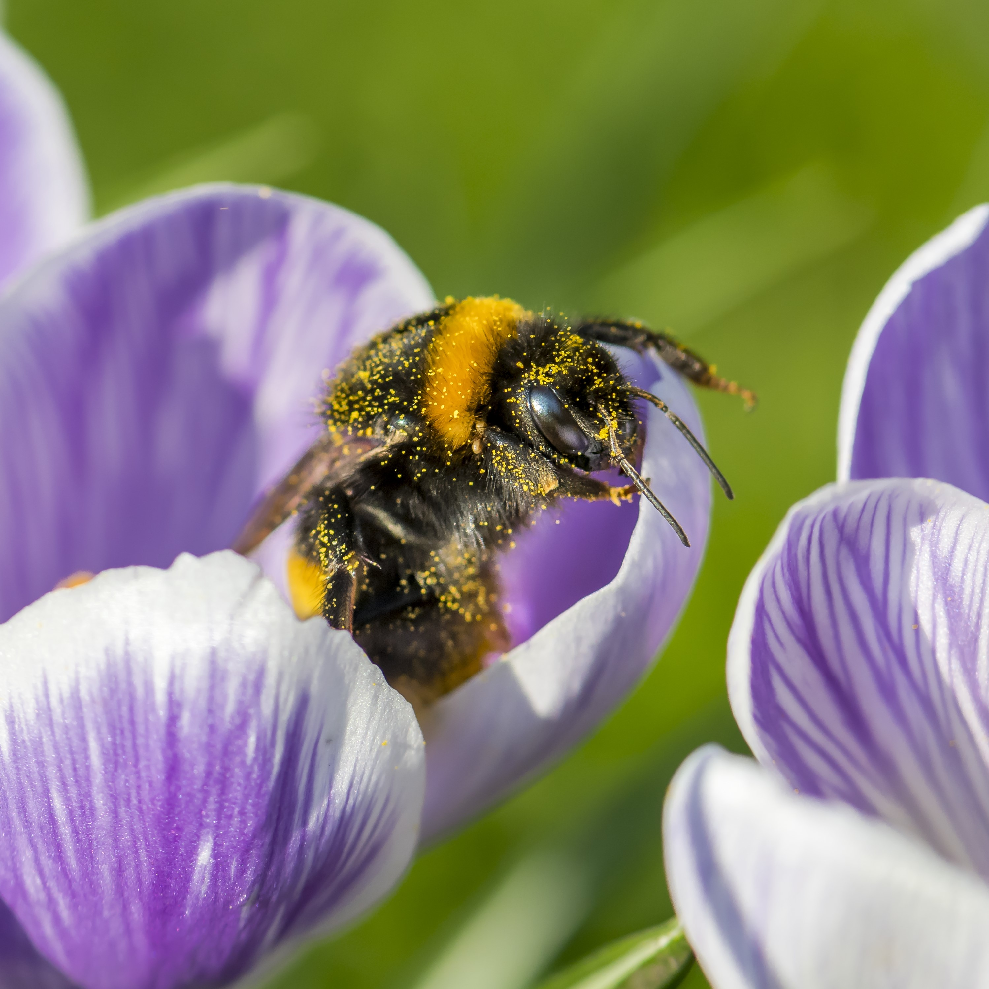
Crocus
and #CrocusChallenge
After the cold, wet shorter days of winter nothing lifts the spirits more than seeing the first signs of spring bulbs emerging. Although winter is a quiet time for most pollinators by planting bulbs you'll be giving them a head start.
Plant info
When to plant: Sept- Nov
Sun: Full sun
Soil: Free draining
Hardiness: Fully hardy
Other: Perennial
The Buzz Club's #CrocusChallenge aims to increase the number of crocuses planted across the UK.​​
To take part in this challenge:​
Plant your crocuses​
When they bloom, share your photos on socials by tagging us and #CrocusChallenge or email them to us at buzzclub@sussex.ac.uk​
We will then share your photos on our socials and website!
There are two different types of crocuses- spring flowering and autumn flowering. The best time to plant your Spring crocus bulbs is between September to November.​
Great for early pollinators!

