Slide 1
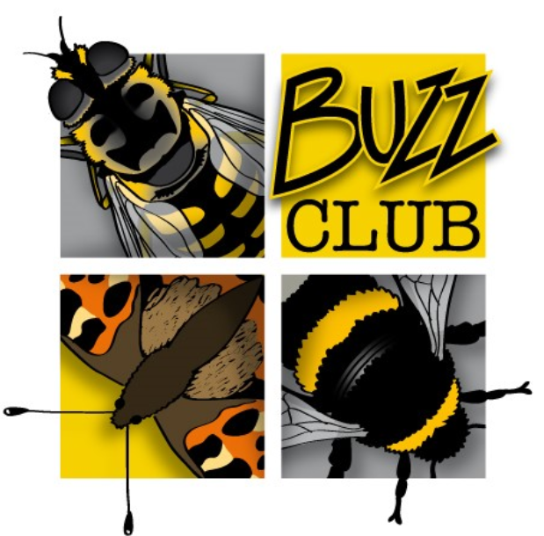
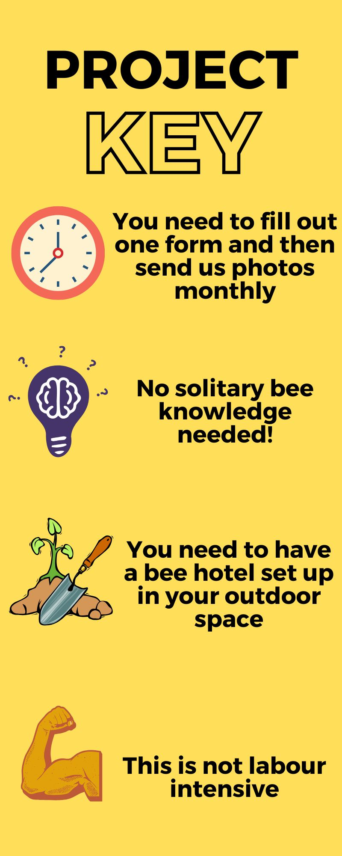
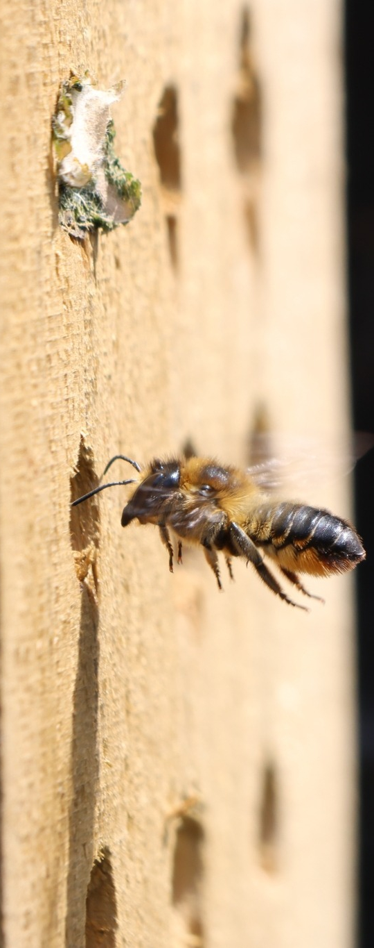
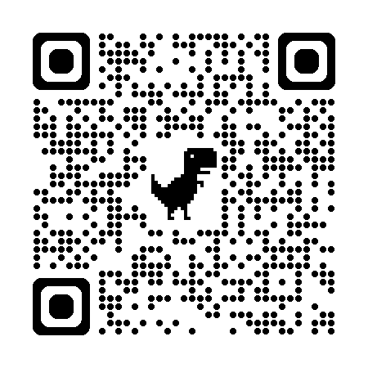

The Big Bee Hotel
Experiment 2026
Background
Most of UK’s bees are solitary and do not live in colonies like bumblebees or honeybees. They are very important pollinators, but less well-known than their social relatives. Many are 'cavity nesting' bees, with the females creating individual 'cells' inside tunnels using mud or leaves, into which they lay an egg. Each cell is then packed full of pollen, providing food for the larvae as it grows over the Summer. The offspring then hibernate to emerge in Spring as new adults.
Did you know that we have approximately 270 species of bee in the UK and 250 of those are solitary?​
We want to investigate what design features/location bees favour in solitary bee hotels and how to make them optimal for as many different bee species as possible. Finding this out will help us conserve pollinators in our gardens across the UK and help protect them against threats such as climate change!
What we know so far
This will be the third year this project has run. So far, we have collected data from 1003 bee hotels. We are currently in the process of writing a report for publication and thanks to your hard work, we now have a great insight into the preferences of these bees. All of this will be presented in ‘The Big Bee Hotel Experiment: Retrospective’ webinar shortly.
Filling the knowledge gaps
From analysing the data collected from 2024 and 2025, a couple of new questions have arisen. This year you can choose from two projects to help us answer these questions!
Sam James
Sam James
Any questions? Contact us!
Email: buzzclub.uk@gmail.com
Website: www.thebuzzclub.uk

Slide 2
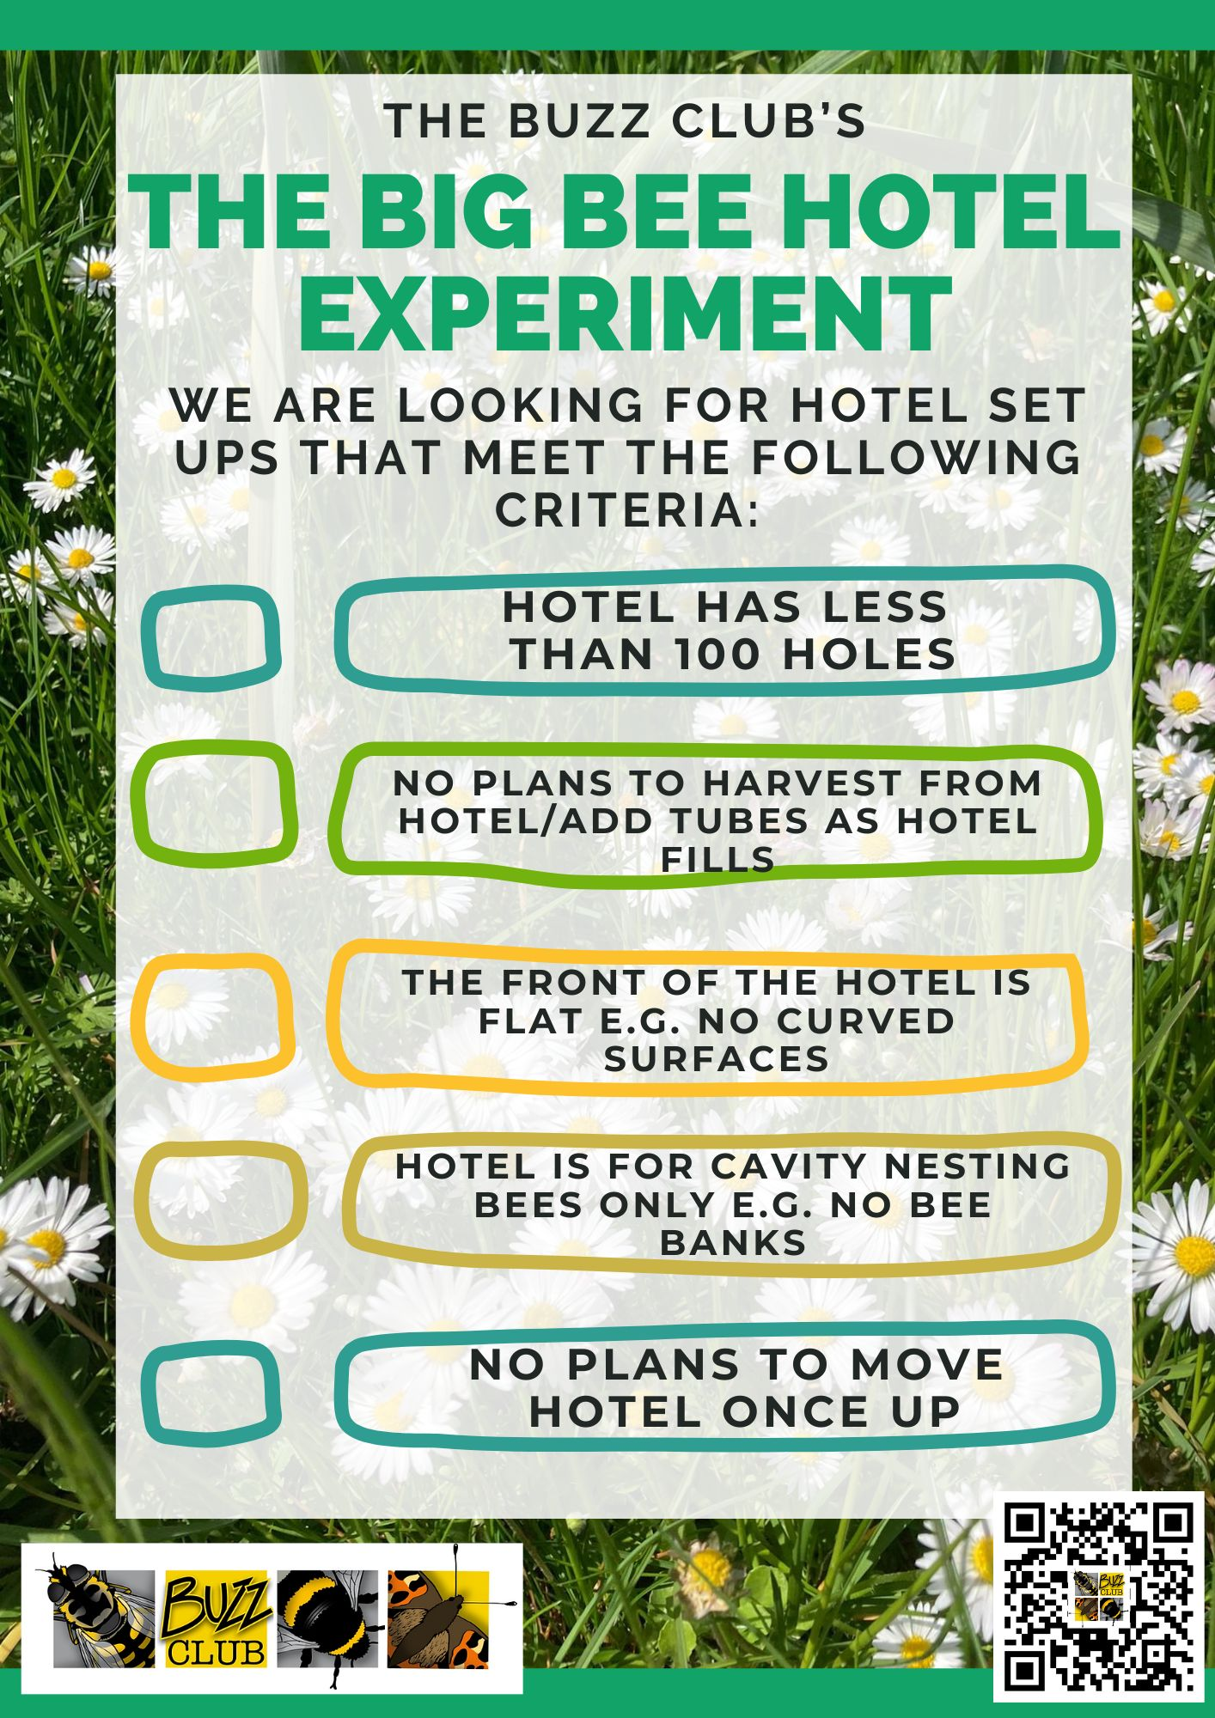
Your Project Choices
The Big Bee Hotel Experiment 2026
Both of the new sub-projects on the following page need what we call a ‘control’ data set for comparison. This means that firstly we are looking for bee hotels in the exact same way as previous years!
If you have a bee hotel that fits the below criteria, please register it with us as early in the bee season as possible. You will be able to do this from late March to the end of May. You will be asked questions about the dimensions of your hotel, along with the location you have placed it in. You will then be asked to send us a photo of your hotel once a month.
If you have one hotel, it is up to you if you would like it to be a control hotel, a Late Check-In hotel or a Bee Creative hotel. If you have more than one hotel, fantastic, the more the merrier! Please consider registering one as a control hotel and then choosing one of the sub-projects for your other hotel(s).
All bee hotels in this project (no matter the sub-project) need to fit this criteria.
Any questions? Contact us!
Email: buzzclub.uk@gmail.com
Website: www.thebuzzclub.uk

Slide 3
Your Project Choices
Late Check-In: Investigating the preferences of late-season bees
In early Spring, the most common bee to move into your bee hotel is the red mason bee. In our current data set, 80% of the holes filled in hotels were done so by red mason bees. This means that only 20% of the preferred holes in your bee hotels were available for later-season bees such as leafcutter bees.
We now have data showing the preferences of bee hotel residents, but does the lack of available holes for later-season bees skew our data? Are they just moving into the spaces that are left in a hotel rather than the ones they would prefer?
This year, we would like participants to put up a bee hotel in June, after the red mason bee season is over. If you have more than one hotel, please consider installing a hotel in March and then saving a second for June. More information on what we need you to do for this will be emailed to you upon registration.
This data will greatly help us to fill any knowledge gaps we have about the interactions between these nesting bees and their preferences.
Bee Creative: Designing colourful homes for pollinators
Bees have a lot to see and distinguish between when flying around – they have to be able to spot flowers at speed, learn where the best pollen and nectar sources are, as well as be able to find available nesting sites. Not only that, they have to remember how to find their nests when they leave and return from a foraging trip. We want to know if we can help them to better spot their hole in a bee hotel.
This project asks you to decorate your bee hotel with a non-toxic marker/paint, clearly differentiating between available holes. Examples of how to decorate these will be given upon sign up. We will then ask you to register your bee hotel with us and send us a monthly photo so we can determine the popularity and whether this makes a difference!
What to do now?
Register your interest with us on our website and you will receive more information on the above and instructions on the next steps!
Any questions? Contact us!
Email: buzzclub.uk@gmail.com
Website: www.thebuzzclub.uk

