Slide 1

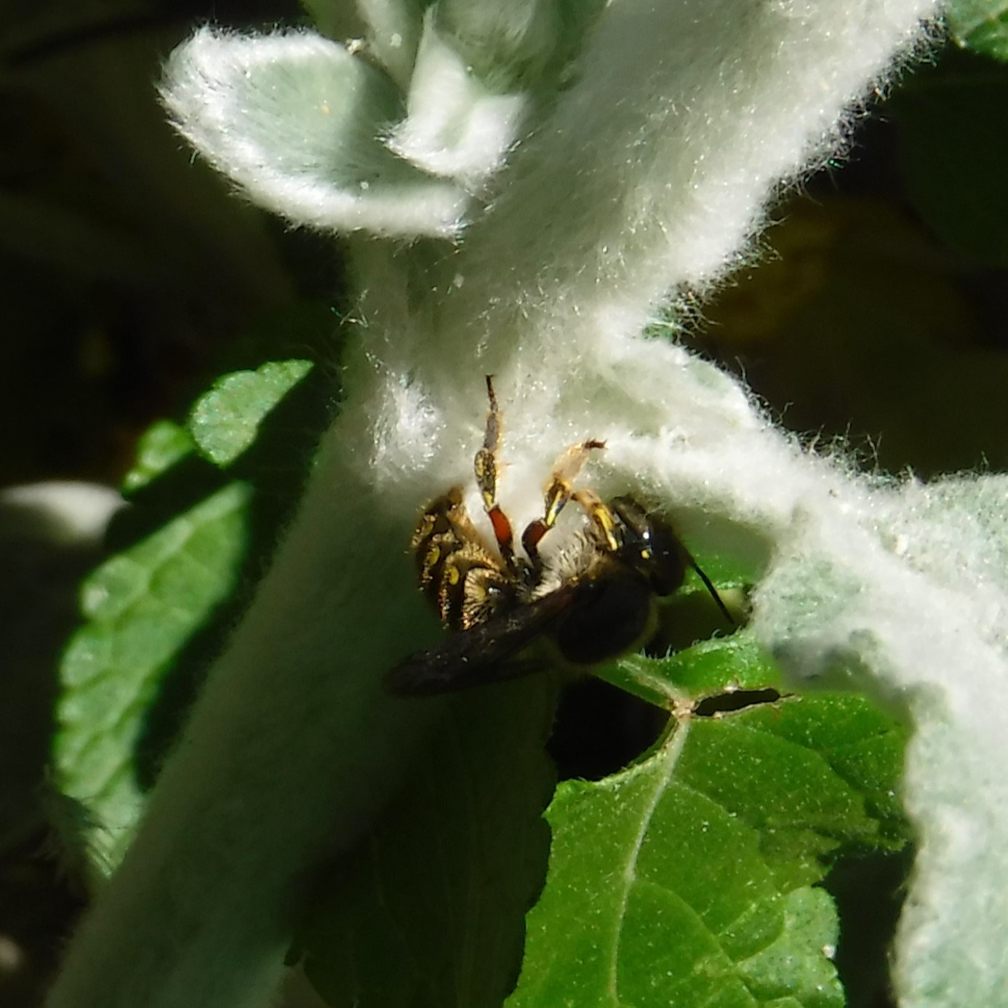
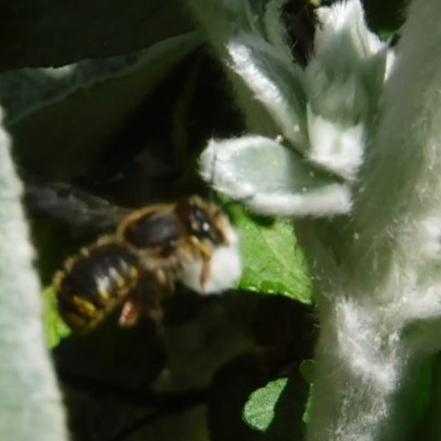
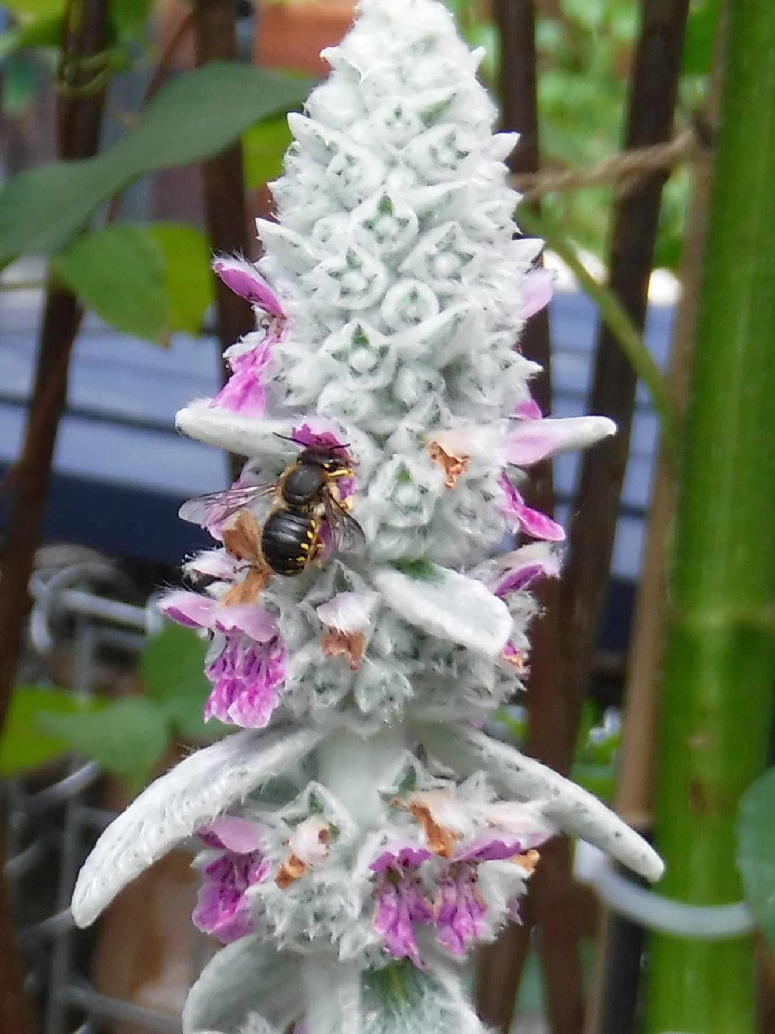
Stachys byzantina
Non-native
& the wool carder bee
What can beat whiling away an hour (or two) watching a wool carder bee at work rolling up the hairs off a Stachys stem?
Did You Know?​
The wool carder bee is the only UK species in its genus.
Spring is the perfect time to sow Stachys seed and divide existing plants​.
​It is not just the furry stems that this bee finds useful but is fond of its pollen and nectar.
The female rolls up the hairs into a ball and then takes it to the cavity to line the nest.
Stachys byzantina is also known as ‘Lamb’s-ear’
Plant info
When to plant: May-Sep
Sun: Full sun/ Partial shade
Soil: Moist, well–drained
Hardiness: Fully hardy
Other: Perennial, evergreen
Other plants these bees
might enjoy:
Achillea millefolium
Verbascum thapsus
Pelargonium
Onopordum acanthium
Native species to the UK in bold.
The wool carder bee is a solitary bee and a cavity nester like mason and leafcutter bees.
It is on the wing from late May to August.

