Slide 1
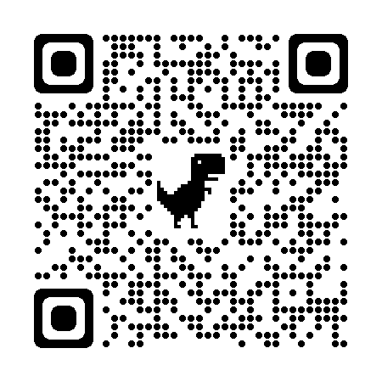
Ivy Bee Snapshot
The Ivy Bee
Identification
Ivy bees are the last UK bee species to emerge each year, with their flight period lasting just a few weeks between late August to early November. Ivy bees are similar in size to a honey bee, but have a buff-coloured hairy thorax with a black and yellow striped abdomen. They are not aggressive and are very unlikely to sting.
Foraging
This species, unsurprisingly, are so-called as
they feed predominately on ivy flowers. This is
also the reason they emerge later than other
bees – they wait until the ivy is in bloom.
Nesting ecology
Ivy bees are a type of 'plasterer' bee. They are solitary bees, but are willing to nest gregariously. The females will dig a main tube, up to a metre long, into the ground. This tube is communal. Each female will then create her own chamber for her eggs which she seals using a waxy substance she secretes from her Dufour’s gland. This keeps her eggs safe from any diseases and environmental changes.
Aggregations
Male ivy bees emerge in late August, females slightly later. The males will aggregate around nests in their hundreds and compete to mate with the emerging females, bundling together in chaotic ‘mating balls’!
Distribution and colonisation
The ivy bee was first discovered in the south of the UK in 2001, after colonising here from mainland Europe. Since then, they have been seen to spread to Wales and are now being seen in the North of England. They are considered an introduced species but not an invasive species. As far as we know so far, they have no negative effects on our other bee species as they occupy a different ecological niche – no need to compete for foraging or nesting materials!
An ivy bee
Any questions? Contact us!
Email: buzzclub.uk@gmail.com
Website: www.thebuzzclub.uk

Slide 2
The Ivy Bee Snapshot
This project consists of two parts: Ivy survey and Aggregations. Since you might not easily find a nesting site, the main focus of this snapshot will be on the ivy flower survey (see next page). If you are lucky enough to find a nesting aggregation, please also fill in the aggregation survey (below). Please return all data back to us by email.
BWARS
After submitting to us, please then submit your data to The UK Bees, Wasps and Ants Recording Society’s (BWARS) long-term mapping project of Ivy Bees in Britain: https://bwars.com/content/submit-sighting-colletes-hederae-ivy-bee
The Aggregation Survey
If you find an aggregation, please measure the area and estimate the number of individuals you see using the table below. This survey will investigate where aggregations occur and how large they can be. The two last columns are optional.
Name: Post Code of Aggregation:
Email: Date:
Weather and temperature ('C) | The area (length x width) of the aggregation (where you see bee activity) in m² | What is behaviours are being displayed? (Lots of bees flying above the holes = males investigating; many bees piling together = mating; singular bees going in and out of holes = females) | Estimate how many bees there are in the total aggregation area (easiest to estimate per m2 and multiply for the area) | Estimate how many holes are in the aggregation area (if there are too many bees to do this on your first visit, return a few days later)
e.g. sunny, 20'C | e.g. 9 | e.g. mating | e.g. 450 | e.g. 20
Any questions? Contact us!
Email: buzzclub.uk@gmail.com
Website: www.thebuzzclub.uk

Slide 3
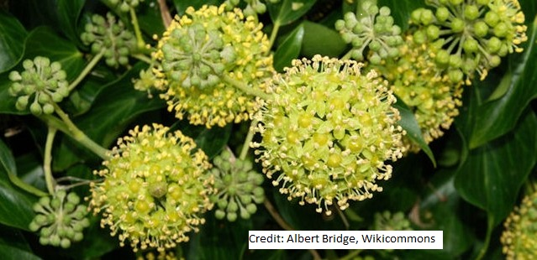
The Ivy Survey
This survey will investigate where Ivy Bees are found and how they behave
on Ivy flowers.
Instructions:
Find an ivy bush that
is in flower. Choose 10 umbels to survey
2) For 10 minutes, survey these
Umbels, filling in the table
below per ivy bee you see.
Label each bee individually
e.g. ivy bee ‘a’, ‘b’ etc.
Ivy flowers cluster together in ‘umbels’. This illustration shows one umbel. You need to ensure the umbels you choose are in flower, shown here. Those circled in blue are not in flower.
Name: Post Code:
Email:
Ivy Bee individual | Number of umbels visited by that individual | Are there any other insects sharing the visited umbel(s)? If so what and how many?
e.g. a | e.g. 3 | e.g. 2 Hoverflies
Any questions? Contact us!
Email: buzzclub.uk@gmail.com
Website: www.thebuzzclub.uk

