Slide 1
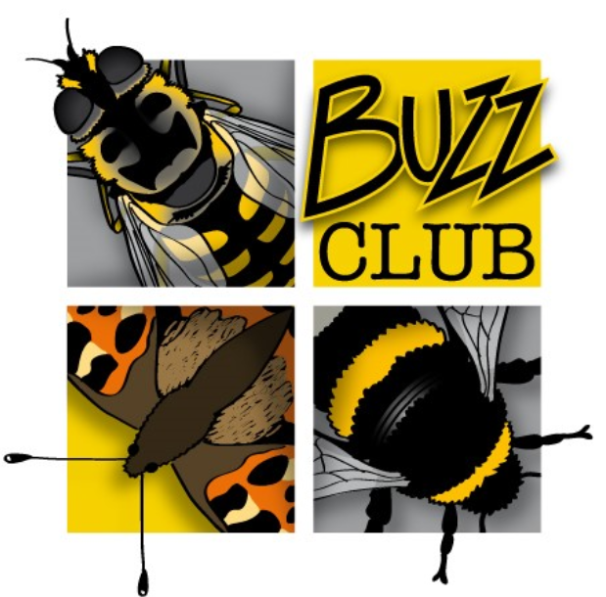


Pet Waste Watch
Background
Fleas, ticks and worms are parasites that dog owners must be mindful of for their pets. There
are treatments commonly available that target ectoparasites (those who live on the surface of the skin) and endoparasites (those who live inside the host’s body). It is often advised to treat your pets prophylactically with tick and flea treatments (monthly) to prevent the opportunity of parasitic activity, applied orally or topically. You can also very easily buy these treatments at supermarkets or online without any professional advice (or age restriction!).
What we know so far
Worryingly, recent research has highlighted that using flea treatments like this is causing detrimental impacts to the environment. For example, the active ingredients in several popular brands are imidacloprid or fipronil, both chemicals that have been banned in the EU for agricultural use due to the human health risks and toxicity to pollinators (e.g. 1 gram of imidacloprid is enough to give a lethal dose to 250 million honeybees). Interestingly, these products are not subjected to a detailed environmental risk assessment, due to the idea that only one animal is treated at a time. While the impact of one dog’s flea treatment on the wider environment may be small, the impact from the estimated 20 million dogs (and cats) in the UK (80% of which are treated with flea treatments) is alarming. Research by scientists, including Buzz Club Director Prof. Dave Goulson, has shown that the chemicals in flea treatments come off pets and remain active in the environment for weeks via bed washing; dog swimming is polluting water bodies; shed fur is being used for birds’ nests, to name a few.
Pet Waste Watch – investigating something new
Due to concerns over the safety of these chemicals, many vets are now recommending alternative drugs such as isoxazolines, normally given orally. However, these alternatives have not been subject to an environmental risk assessment, and may create different problems, such as harm to dung-feeding insects when excreted in faeces. Pet Waste Watch will investigate whether use of anti-parasitic drugs on dogs affects the degradation of dog faeces. Not a glamourous project, but an important one.
Faecal waste from dogs is considered to be ‘offensive waste’ in the UK due to the risks of contamination it provides to the environment via a) pathogens and natural chemical composition e.g. high nitrogen levels b) contamination via endo/ectoparasitic treatments (information on different chemicals can be found on our website). We want to look at the speed at which dog poo breaks down naturally outdoors, and how this relates to the insecticidal treatments that the dog has received. Do these treatments slow down the process or are some less impactful than others e.g. spot-on vs tablet treatments? Are the invertebrates that play important roles in decomposition affected?
We are looking for dog owners who have their dog on any parasiticidal treatment plan (ecto and/or endoparasitic), and those who don’t treat their dogs for these parasites at all – in other words, all dogs are welcome!
We are asking dog owners to:
Register your dog as a citizen scientist with us!
Record the degradation weekly of one of your dog’s poos.
We will also throw a 'Dogs as Scientists' photo competition!
Any questions? Contact us!
Email: buzzclub.uk@gmail.com
Website: www.thebuzzclub.uk

Slide 2
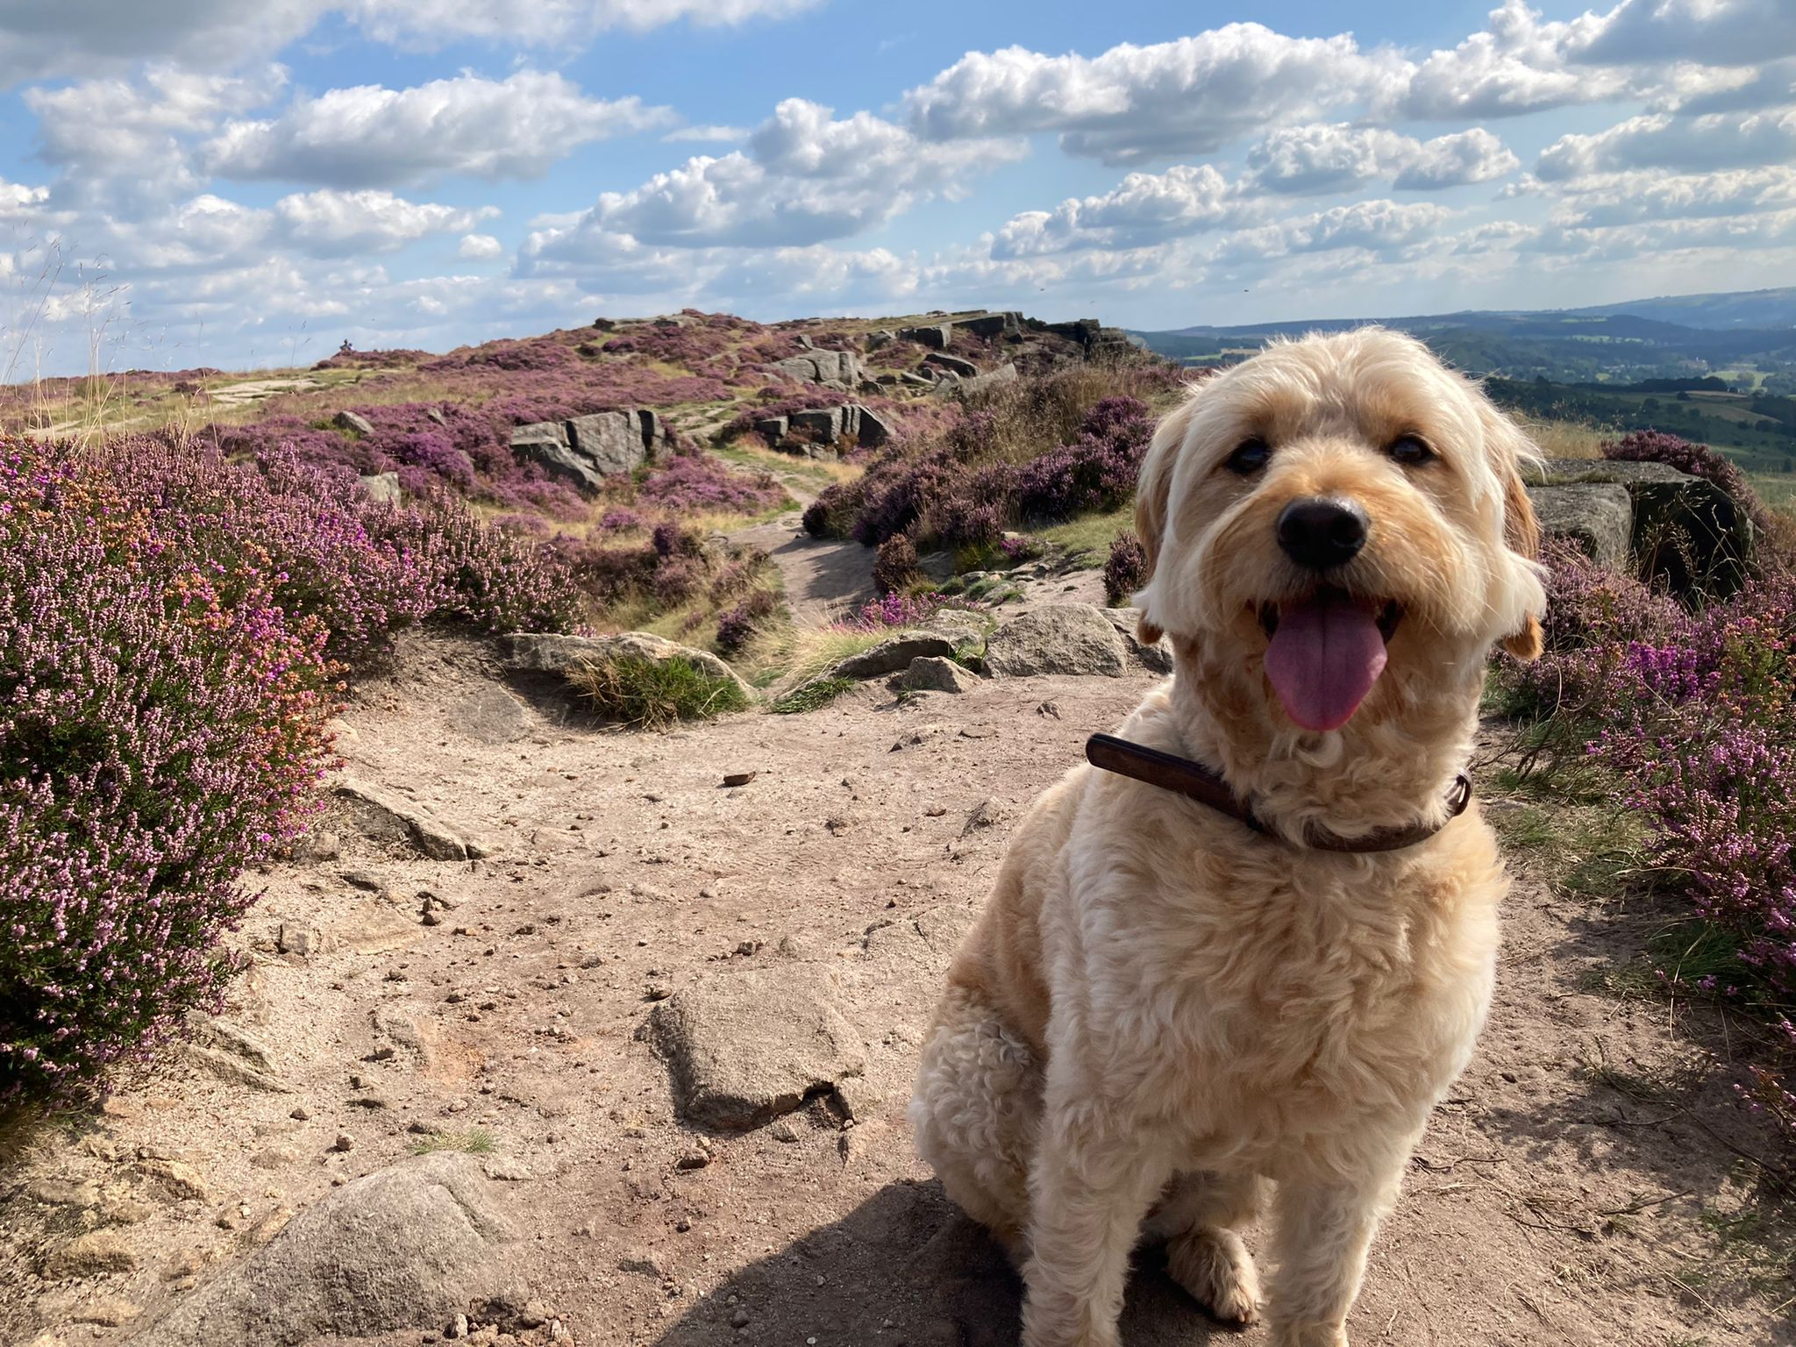
What we need from you!
You can take part if you have a dog and a private outdoor space.
Register your interest on our website
You will then hear from us via email with the next steps! These are outlined below but will be explained in further detail via email.
2) Tell us about your dog!
We will need to know a few details about your dog, including age and weight, along with details of your pet's last parasiticidal treatment.
3) Your survey
You will be sent a form for data collection. When your dog next poos, the survey can begin! You will need to measure the poo, note the date and watch it for 1 minute for invertebrate activity. We will also ask you for weather conditions.
You will need to complete this weekly for 9 weeks (the approximate time of degradation).
We need your help to get more environmentally conscious dog owners involved!
Please share a photo of your dog on socials with #PetWasteWatch
Suggested caption:
[Enter dog name] and I are taking part in the Buzz Club's #PetWasteWatch to help protect the environment from pesticides! Make a difference to real science and join in this research today. All you need is a dog and a private outdoor space. Find out more here: https://www.thebuzzclub.uk/pet-waste-watch
Any questions? Contact us!
Email: buzzclub.uk@gmail.com
Website: www.thebuzzclub.uk

Slide 3

Our Project Partner: Small World Vet Centre
We are delighted to partner with Small World Vet Centre for this project, which is the UK pioneer of making testing for parasites (rather than routine treatment) the norm, and tailoring necessary treatment to the individual needs of the pet. Small World Vet Centre believes that the health of people, animals and the environment are all linked and must be considered one, making them a perfect partner for the Buzz Club.
Any questions? Contact us!
Email: buzzclub.uk@gmail.com
Website: www.thebuzzclub.uk

