Slide 1

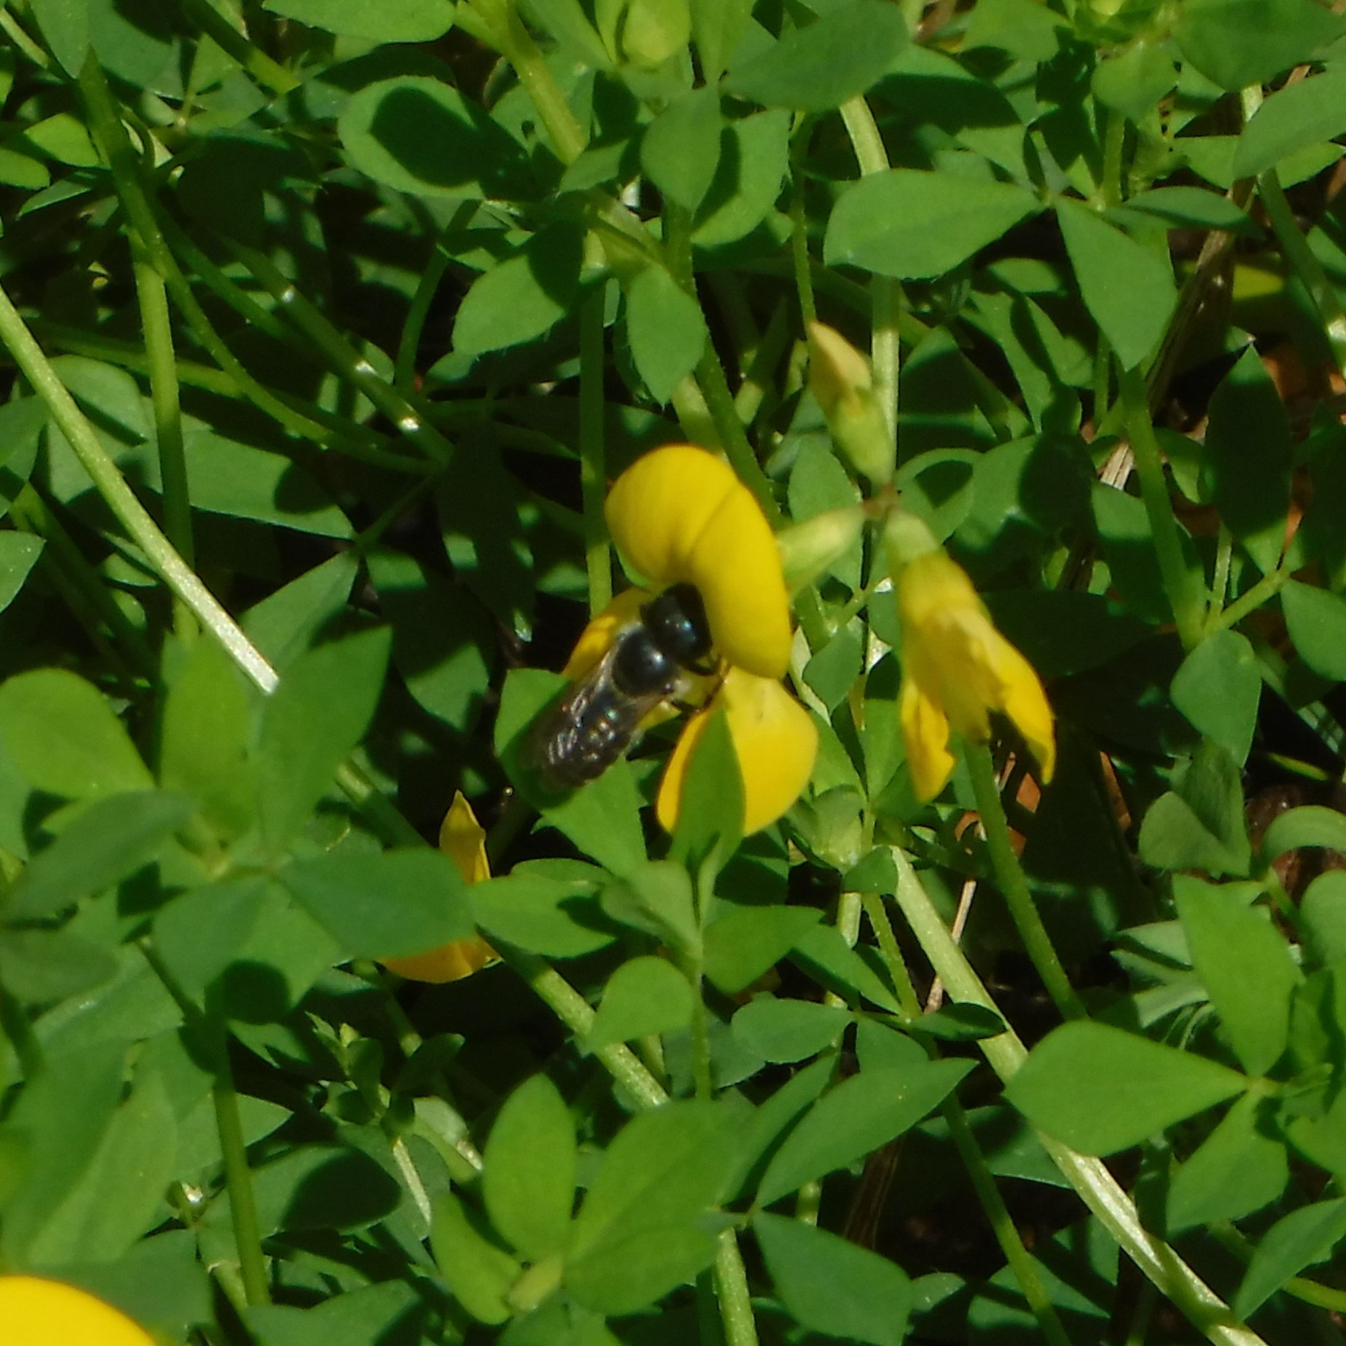
Bird’s-foot Trefoil
Native
& mason bees
What’s your favourite snack? A piece of fruit or a cheeky bit of chocolate? For most mason bees, it’s birds-foot trefoil. There are 11 different types of mason bee in the UK. They are a medium sized bee, with differing colourings – many with orange markings.
Other plants these bees might enjoy:
thistles
wood anemone
dandelion
knapweed
daisy-type flowers
Native species to the UK in bold.
Plant info
When to plant: Spring or Autumn (depends if sowing from seed or plugs)
Sun: Full sun
Soil: Well Drained
Hardiness: Fully hardy
Other: Perennial, Herbaceous
Mason bee feeding on bird’s-foot trefoil flower.
Did You Know?
Bird's-foot trefoil is also the larval food plant for the Common Blue, Green Hairstreak and Dingy Skipper butterflies.
Mason bees do not fly far for food, unlike honeybees who travel on average 1km a day to forage, so if you do decide to plant some birds-foot trefoil place it near your bee hotel where they can find it. ​
Bird’s-foot trefoil is a robust plant and can grow in difficult soil conditions (it is perfect for grassy and coastal habitats). Pollinating insects find it a great source of nectar.

