Slide 1

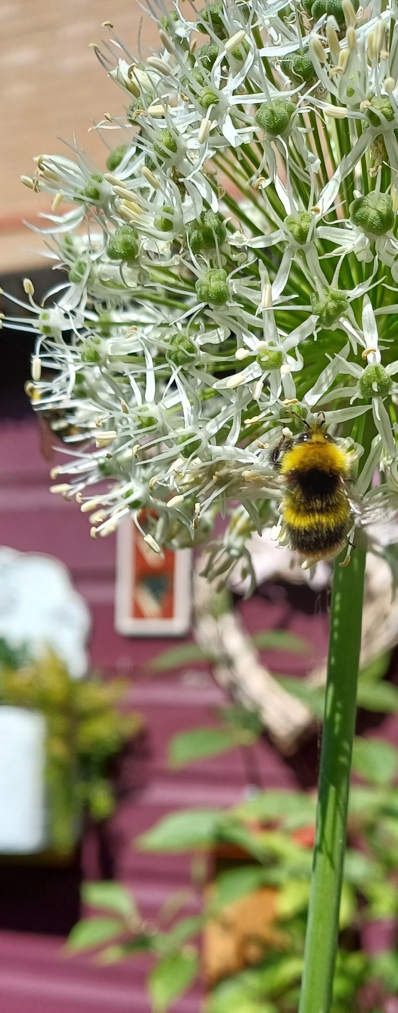
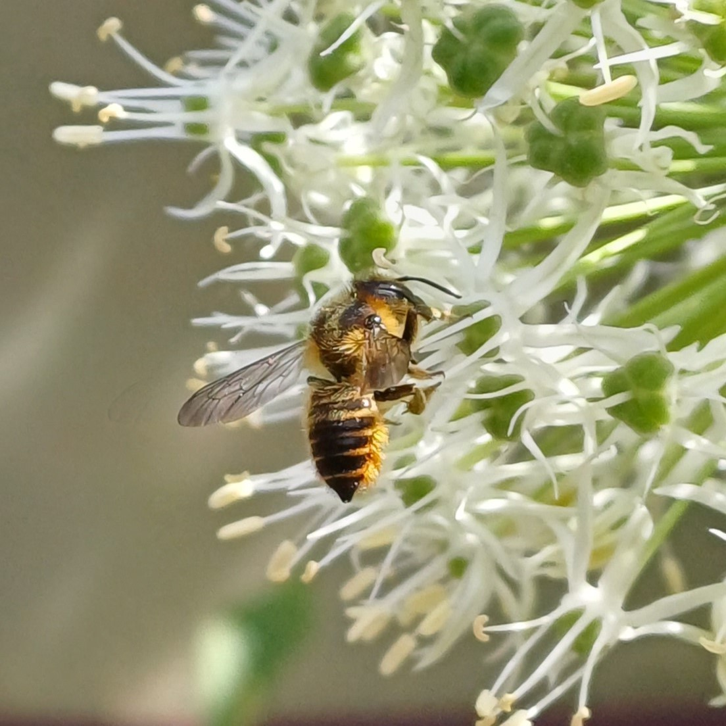
Alliums
Non-native
and short-tongued pollinators
The genus Allium includes many plants which are familiar to all such as garlic, onions, leeks and chives. Add to a late spring garden with showy flowerheads that bob in the breeze.
Did You Know?
Some short-tongued bees such as the Buff Tailed bumblebee will rob a deep flower by making a hole at the back of the flower to reach the nectar.
They are also a welcome sight for our short-tongue pollinators who need short, open flowers, with nectar that is easy for them to reach.
Other plants these pollinators might enjoy:
Oxeye daisy
Geranium
Borage
Thyme
Dandelion
Nepeta
Native species to the UK in bold.
Plant info
When to plant: Early to mid-Autumn
Sun: Full sun
Soil: Free draining
Hardiness: Fully hardy
Other: Perennial
Leafcutter bee feeding on allium 'White Giant'

