Slide 1

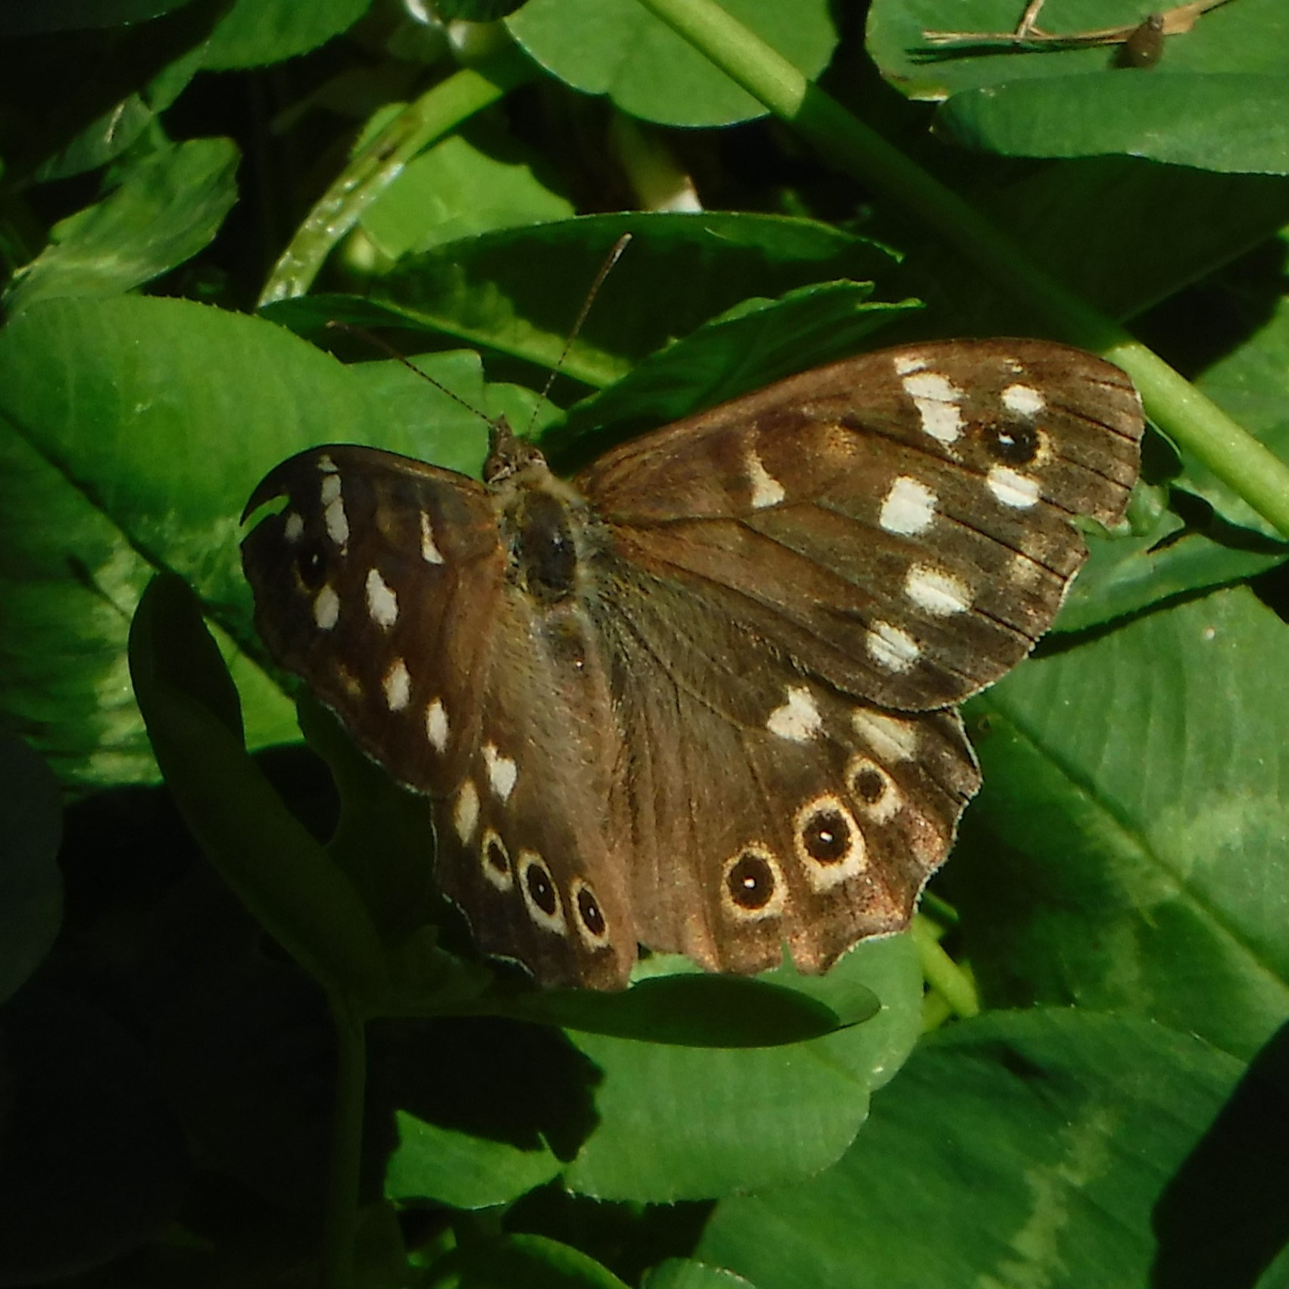
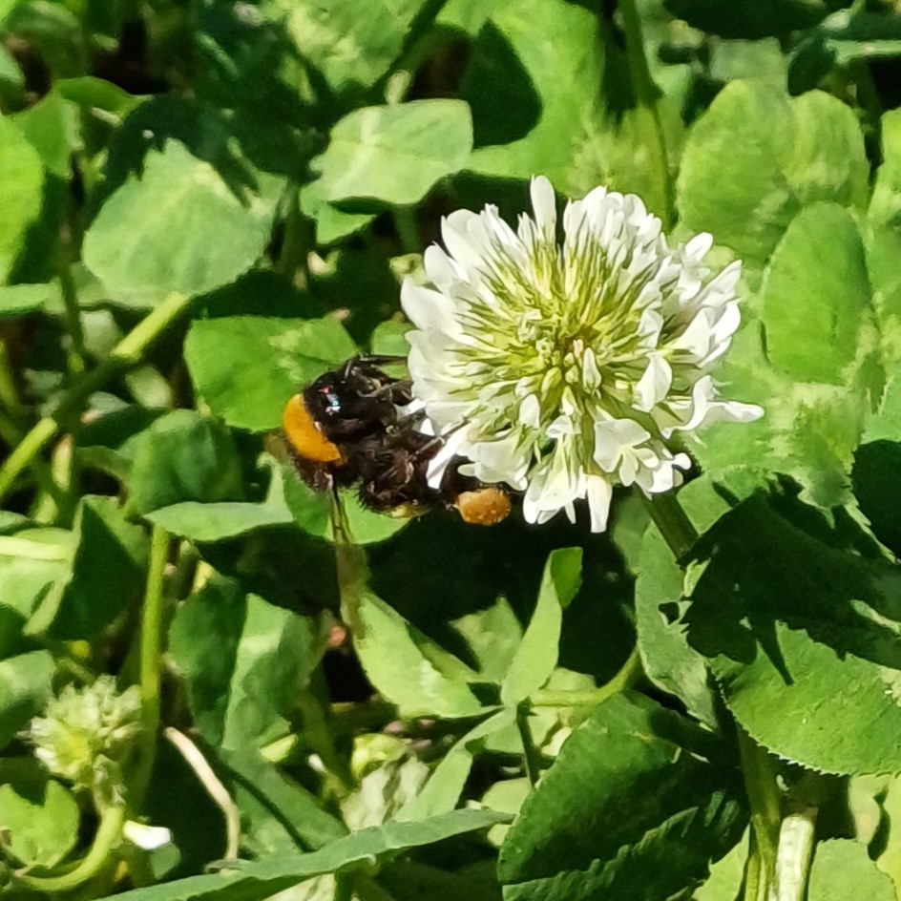
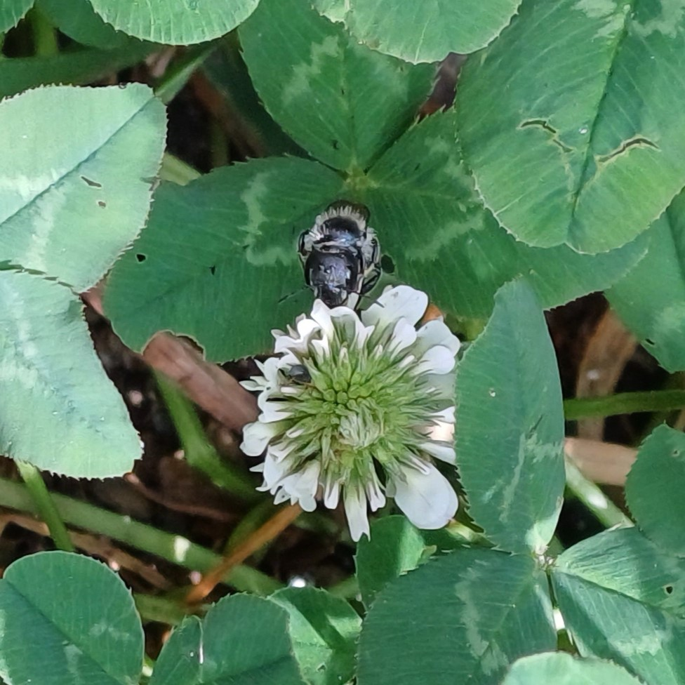
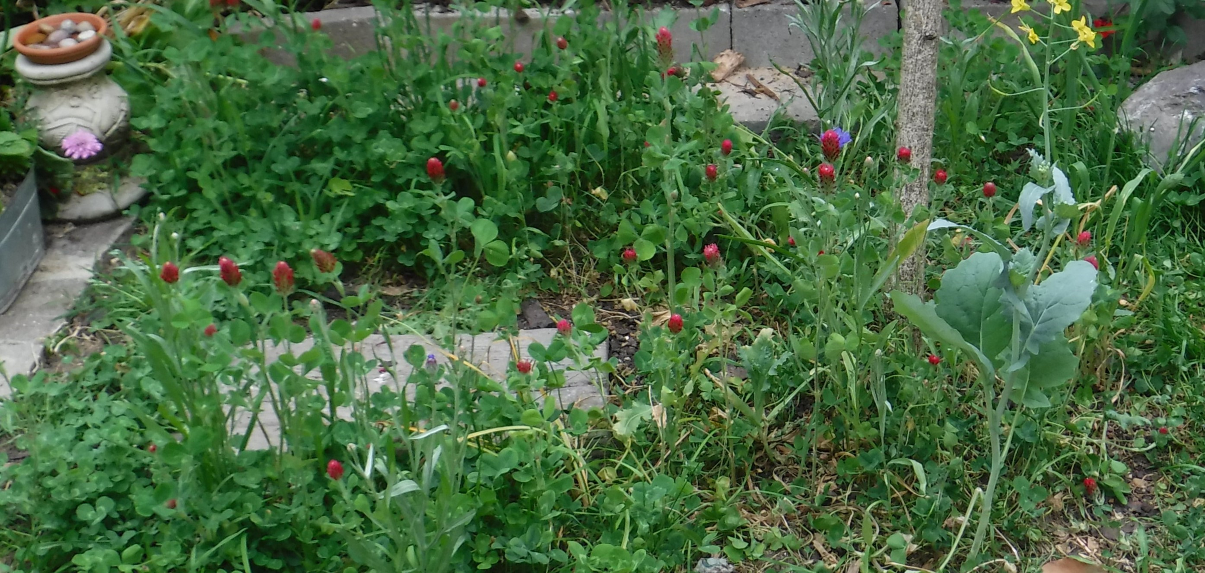
Clover patch
Create a
Native
for beneficial insects
Once clover was the scourge of the pristine garden lawn but now gardeners are recognising the value of clover to beneficial insects. Not only that but clover is drought tolerant so will stay green even when the weather heats up!
1
Plant info
When to plant: April - August
Sun: Full sun
Soil: Well drained
Hardiness: Fully hardy
Other: Perennial, semi evergreen
2
White clover is rich in nectar for short tongue pollinators and red clover will be visited by those with longer tongues.
Other plants you might like to introduce to your patch of clover.
red clover
ox eye daisies
Field scabious
Naturalizing bulbs
Cornflowers
Native species to the UK in bold.
3
Butterflies
Bumblebees
Solitary bees

