Slide 1
Bees & Heatwaves
Bumblebees are essential for our ecosystems, playing a critical role in pollinating numerous crops & wildflowers. However, due to their thick, furry coats, they may be prone to overheating in hot weather. With the increasing frequency and intensity of heatwaves, it is crucial to understand how these pollinators cope in the challenging conditions.
Some animals alter the time of day that they are active during environmental changes. With your help we will be able to answer the following questions:
a) Do bumblebees change their activity patterns in a heatwave?
b) Which plants do they visit during a heatwave?
This data will help us create a guide showing how we can all help bumblebees during the extreme weather conditions, which are unfortunately becoming common in the UK.
It will include suggestions on what plants serve as vital food sources and refuge to bumblebees and may also lead to future projects that explore how heatwaves affect different plant species and their reproduction.
Equipment
Pen
Data collection sheet
Something to take photos with
Thermometer/Thermometer App

Slide 2
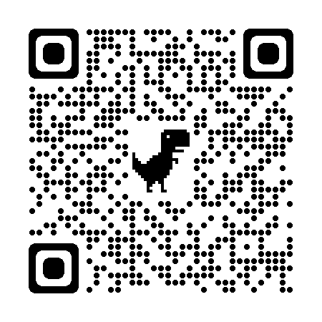
Data collection
1) Choose your patch! This can be in your garden, a park, an allotment etc. It just needs to be an area in which you have seen bees foraging on flowering plants and be 2mx2m in size. Before the heatwave is due, visit your patch, mark it out so you can find it again and fill out the study site data sheet below. This way you will already know your plant species!
2) Observations
Below are the instructions on how to collect your data. You will need to do this at the following periods:
Before the heatwave: observe it for 3 days – we will let you know when
During the heatwave: observe until it is over (approx. 2-3 days)
Once the heatwave is over: wait for 3 days and then observe for 3 days
We will let you know when a heatwave is coming and when to start recording, as this may differ between cities. For each of the observation periods above, you will need to observe your patch 3 times a day for 5 minutes each time:
Between 7am-9am (5 minute observation)
Between 1pm-3pm (5 minute observation)
Between 6pm-8pm (5 minute observation)
During each observation, please fill out your data collection sheet attached. If you are unsure of the bee species, take a photo of it and send back to us with your results (labelled by the date and time). Remember: a count of 0 is also important!
3) Email us your data sheets!
FAQs
What if I don’t know what the bee or plant is?
Take a photo and send it to us to identify!
2) What if I miss an observation?
No worries! Just continue observing as much as you can and record the slots that you missed.
3) What if there are too many bumblebees at once?
Take photos of each if you can to identify later. If you can’t do this jot them down as ‘bumblebee’. It is important to give an accurate count of how many bumblebees you see, over identifying. Taking photos should give you enough time to write down how many bees you see, as well their behaviour and plant visits.
Any questions? Contact us!
Email: buzzclub.uk@gmail.com
Website: www.buzzclub.uk

